Slide 1



Shropshire Public Health
School Nursing Service
Presentation
Notes:
Initial slide. ☺
Hello and welcome.

Slide 2

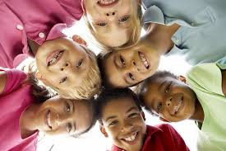
Emotional Health and Wellbeing
Presentation For Children
Improving Lives In Our Communities
Notes:
Introduce the Public Health School Nursing Team, how we are part of the NHS and work with children 0-19 (up to 25 SEND) years of age.
Explain this PowerPoint is aimed primarily at Primary School Children aged 5-11 years, this can be used for other children who may have special or learning needs.
SCRIPT :
This is a presentation about emotional health and wellbeing for children, brought together by the Shropshire public health school nursing service, who work for the NHS.

Slide 3

COVID-19
Has Made Everything Different
Notes:
SCRIPT
Our lives have been have very different because of COVID-19, there have been lots of changes around the world.
It is positive that the COVID-19 vaccine is being rolled out by the National Health Service (NHS) in the UK and many people have had the vaccine now which helps protect all of us.

Slide 4
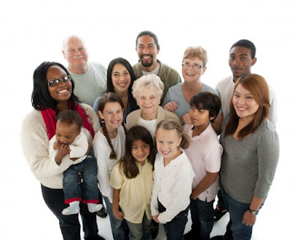
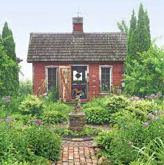
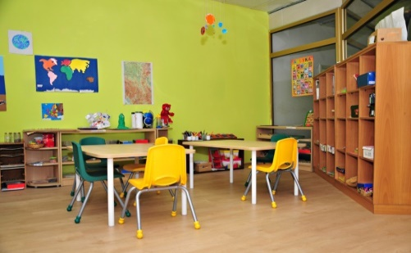
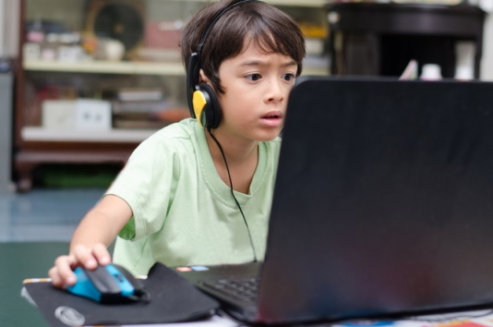
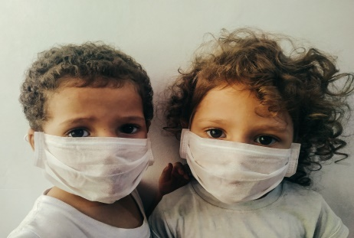
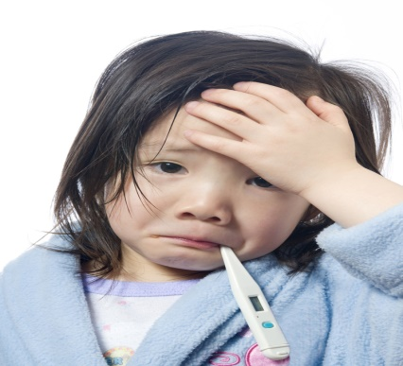
Home
School
Family
Home Learning
Friendships
Illness
Notes:
SCRIPT:
Because of COVID 19 many things we know about have changed, such as :-
- Staying at home when we need to, perhaps missing school,
- Missing your family and friends when you have to isolate,
- Also you may know someone that has been unwell or went to hospital because of COVID19
To help everyone we have had to learn to wash our hands much more, and follow the rules of hands, face, space to make things safer for everyone.

Slide 5
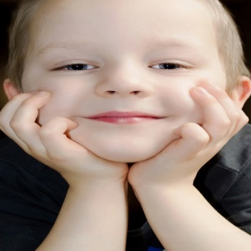
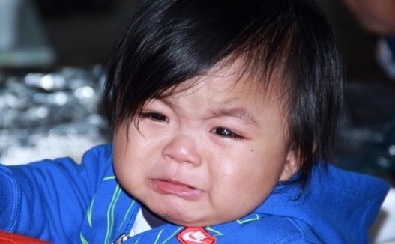
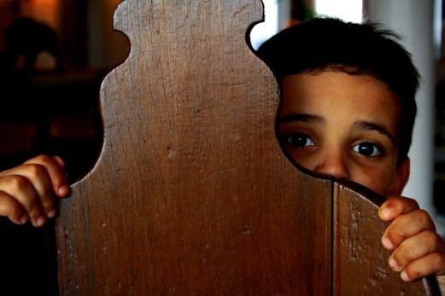
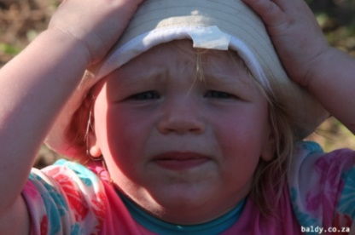
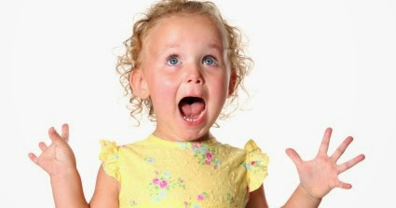
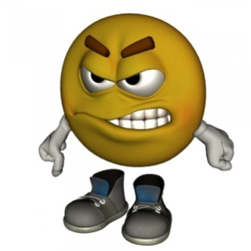
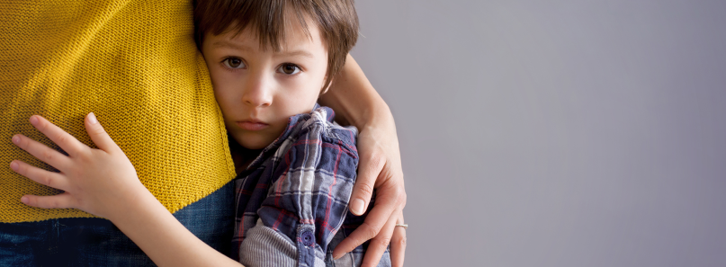
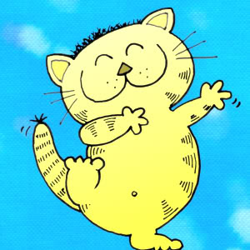
Feelings
Notes:
SCRIPT:
Covid-19 has also made us feel different in lots of ways
These children show some of the feelings we may have had – can you see them? - Happy, sad, frightened, not sure, excited, really cross, super scared, confused.

Slide 6

How Can We Feel Better?
5 Ways to
Wellbeing
Notes:
SCRIPT:
If covid 19 has been making us feel sad, worried , frightened or upset , a good way that we can help ourselves to feel better is to use the 5 ways to wellbeing.
We have used a hand here to remind you about handwashing.

Slide 7
Active
Mindful
Generous
MAGIC
Connected
Interested
Notes:
SCRIPT:
We decided to use the word MAGIC to help us remember what the 5 ways to wellbeing are.
In this picture there are 5 stars each with a different title so lets look at them:-
MINDFUL
ACTIVE
GENEROUS
INTERESTED
CONNECTED

Slide 8
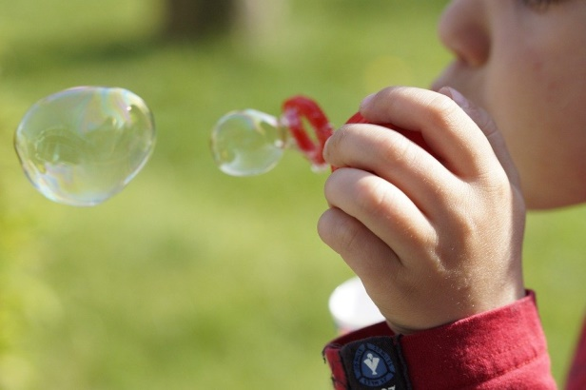
TOUCH
SEE
HEAR
Let’s Be Mindful
TASTE
SMELL
Notes:
SCRIPT:
1..The first one is ‘lets be mindful’.
This is about noticing and connecting with things around us inside and outside, and using our senses to help us feel better. For example we could look at the flowers, listen to the birds, cuddle your favourite toy or smell something really nice.
Our five senses are seeing, touch, hearing, smelling and tasting.
( TOUCH – SENSE OF TOUCH) .
We could do an exercise now called the 54321 Mindfulness grounding technique teacher suggestion

Slide 9
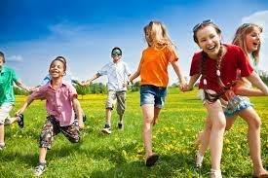
Let’s Be Active
Walking
Running
Swimming
Dancing
Playing at the park
Bike Rides
Notes:
SCRIPT:
2. The second one is ‘Lets be active’
We can really help our bodies if we do at least one hour of exercise each day. When we do, our bodies release ‘happy hormones’ which help us feel good
Exercise could be things such as walking, running, dancing, swimming, riding your bike or ball games.

Slide 10
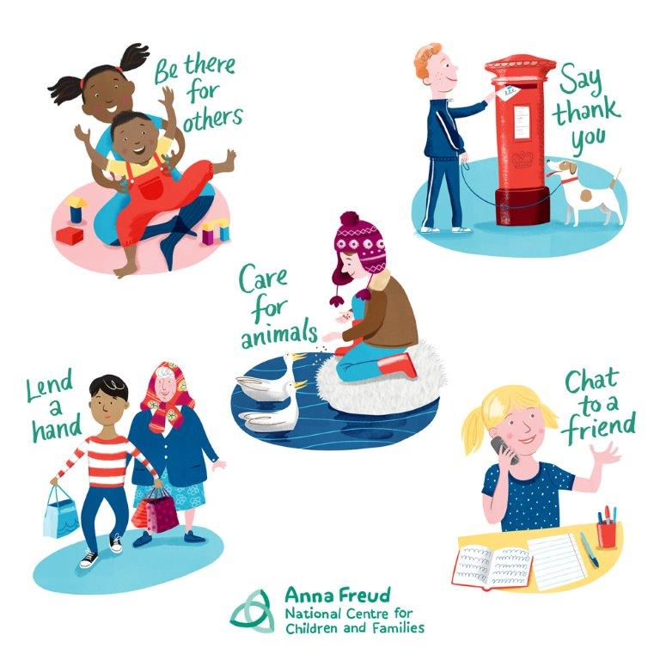
Let’s Be Generous
Notes:
SCRIPT:
3.The third one is lets be generous – here are some ways that you can do this:
- Be there for others,
- Say thankyou,
- Care for animals,
- Lend a hand,
- Chat to a friend.
When we are kind and generous to others we also help ourselves to feel good too.

Slide 11
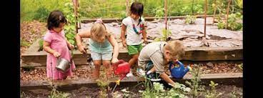
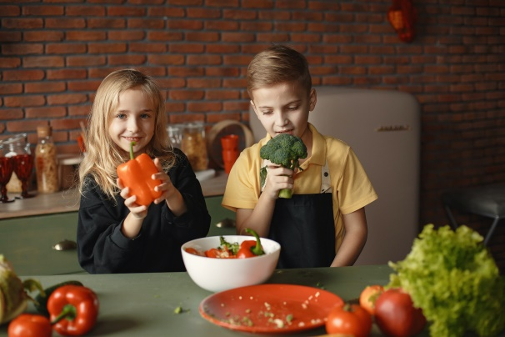
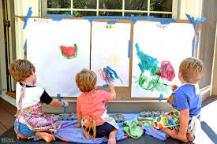
Let’s Be Interested
Notes:
SCRIPT:
4. The fourth one is ’lets be interested’.
It is really good to find new interests and try new things, but it is much easier to do things that you enjoy.
When you do something new it can also help you make new friends.
When we enjoy doing new things it helps keep our minds healthy.
You can see the children in these pictures are doing different things such as playing in the garden, cooking, and paInting some lovely pictures.
Teacher suggestion:
What do you like doing ?
Is there anything that you would like to try to do that’s new?

Slide 12
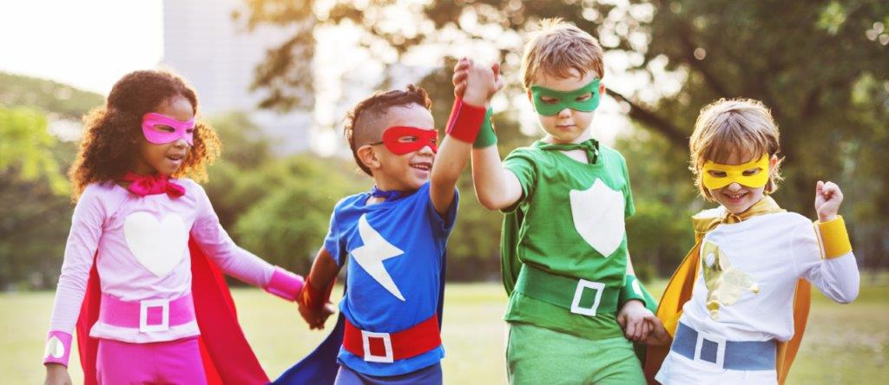
Let’s Be Connected
Taking Turns
Smiling
Sharing
Caring
Being Friendly
Helping
Listening
Say Hello
Ask How are you?
Talking
Having fun
Playing
Notes:
SCRIPT:
5. The fifth one is ‘lets be connected’
When we connect with other people such as our family, our friends, our teachers in a positive way, it can help us to feel better.
The children playing in this picture are all superheroes just like you.
Some things we can do that help us connect, are things like taking turns, sharing, being friendly, saying hello, and smiling at others.
Sometimes making friends is not always easy for everyone, but we can get help , learn how to do this and show each other.

Slide 13
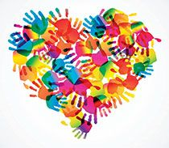
You Are All Amazing
Let’s Dance!
Trolls Can't Stop The Feeling GoNoodle - YouTube
Notes:
SCRIPT:
We think that you are all amazing !
Remember that the ‘5 Ways to Wellbeing’ are
Being Mindful.
Getting Active
Being Generous
Interested
Getting Connected
and if we can do these things regularly we are looking after ourselves and each other.
Play: Example to use for whole group - Lets dance! Video clip.
https://www.youtube.com/watch?app=desktop&v=hRq2iFDJ-98.

Slide 14



Thank You
Notes:
Thank you for listening ☺

Slide 15
Ideas to help support children
Worry box – To put your worries in
Make a ‘looking after yourself box’ for the classroom or home (Emotional health first aid kit)
Teddy bears picnic – Bring an object from home such as a teddy or photo to help make you feel secure
Classroom mindful minute
Daily ‘mile’ or other fun exercise
Notes:
Teacher suggestion
Parents/ teachers – these are ideas that you could use too: -
Worry box,
Looking after yourself box for the class (Emotional health first aid kit)
Teddy bears picnic idea/ get together (Transitional objects to help children feel secure such as teddy from home)
Regular mindfulness mini sessions
Daily ‘mile’ or fun exercise session.

