Slide 1
Accelerated Reader
Information evening for parents

Slide 2
Everyone reads in my house…

Slide 3
What accelerated reader is
A programme to engage children in reading
A way of enabling the school to monitor children’s reading habits
A way of providing support for reading and reading skills, regardless of ability
A way of helping free readers choose suitable books.
Fun!

Slide 4
What Accelerated Reader isn’t.
Not an exact science!
Not the only way we will assess children’s reading
You don’t have to read your way through every book in the colour or range.

Slide 5
Why have we chosen Accelerated Reader?
Attainment and progress in reading in both KS1 and KS2 is not stable: children need to understand what they have read- not just read out loud.
Parent/carers/Children/Crowmoor working together to help children achieve their full potential.
To make the transition from KS1 to KS2 easier from a reading scheme to choosing our own books.
To develop a culture of reading.
To make reading fun with quizzes and rewards.
An aid to Secondary Transition – Belvidere, Meole Brace and Mary Webb: Academy

Slide 6
Assessment
KS1 – Early Literacy Assessment
KS2 – Star Reading Assessment
Pupils will be assessed every half term.
Note: Demonstration of both assessments. Use hyperlink: https://ukhosted45.renlearn.co.uk/2247321/

Slide 7
KS1 Assessment
KS1 – Given a Reading Age and Standardised Score
KS1 & Some Year 3s will still use the Bug Club Scheme.
When Standardised Scores are high enough, they can be converted to a Zone of Proximal Development (ZPD) number range.
KS1 & Year 3 pupils can use this ZPD number range to select other books to develop their reading, as well as reading their Bug Club book. This is a guide.

Slide 8
KS2 Assessment
KS2 – Given a Reading Age, NC (Old) Level and ZPD Number Range.
They will use this ZPD number range to select appropriate books to develop their reading.
But this isn’t the only way we assess children’s reading!
PIRA and Rising Stars-half termly.
Guided Reading weekly.

Slide 9
Reading Diary
My Accelerated Reader
ZPD/ Book Level (B.L.)
Number Range is:
Autumn Term 2018
Spring Term 2019
 | 2.
Summer Term 2019
 | 2.

Slide 10
Selecting Books
Use ZPD number range to choose their reading books.
Inside Cover is labelled with a Book Level (B.L.)
Colour Code directs pupils to books:
0.-1.9
2 – 2.9
3 – 3.9
4 – 4.9
5 - 5.9
6+

Slide 11
Selecting Books
Pupils will be allowed to select books in school to take home to read.
Or use ‘Bookfinder’ website to check the level of own books and if they are on the AR system.
Note: Demonstration of Bookfinder ‘quick’/ ’advanced’ search. Use hyperlink: http://www.arbookfind.co.uk/

Slide 12
Quizzes
Every book on the AR system has a Reading Quiz for pupils to test their knowledge of the book and their comprehension skills.
Pupils to take quizzes in school with Reading Champions at lunch times or independently in guided reading time.
Recommended that pupils take 2 quizzes every half term.
Note: Demonstration of KS1/KS2 Quiz. Use hyperlink: https://ukhosted45.renlearn.co.uk/2247321/

Slide 13
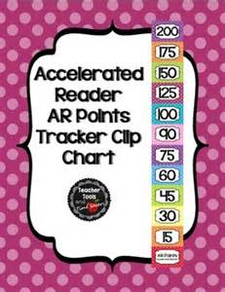
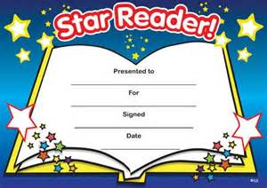
Rewards
Quiz Points
Words Read
Star Readers
House Competitions

Slide 14
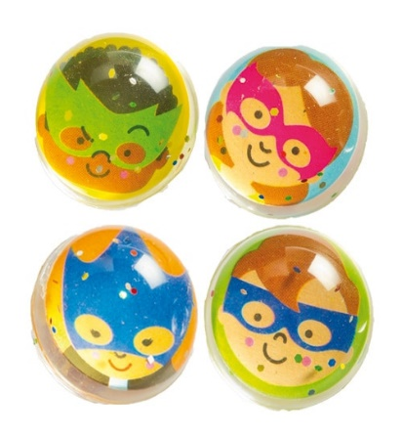
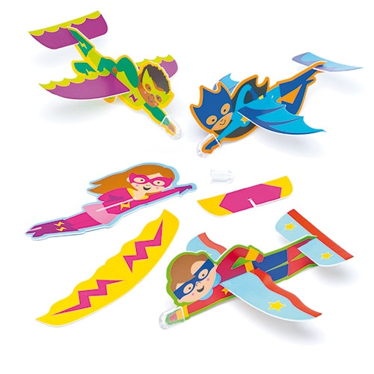
Prizes at Crowmoor
5 Quizzes
10 Quizzes
15 Quizzes

Slide 15
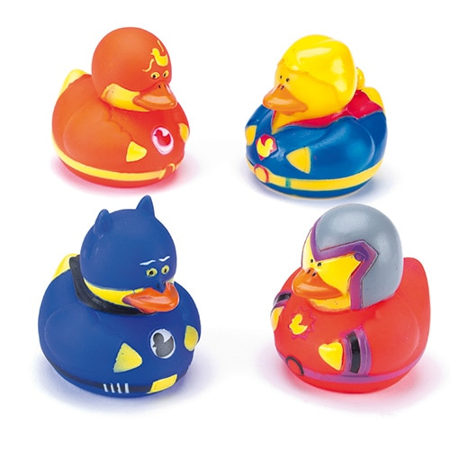
And more…
30 Quizzes

Slide 16
KS1 Record Keeping
KS1 – continue to use Reading Diaries.
Sticker is provided to show ZPD range (if applicable)
KS1 Quizzes will be logged online for Teachers to keep track of.

Slide 17
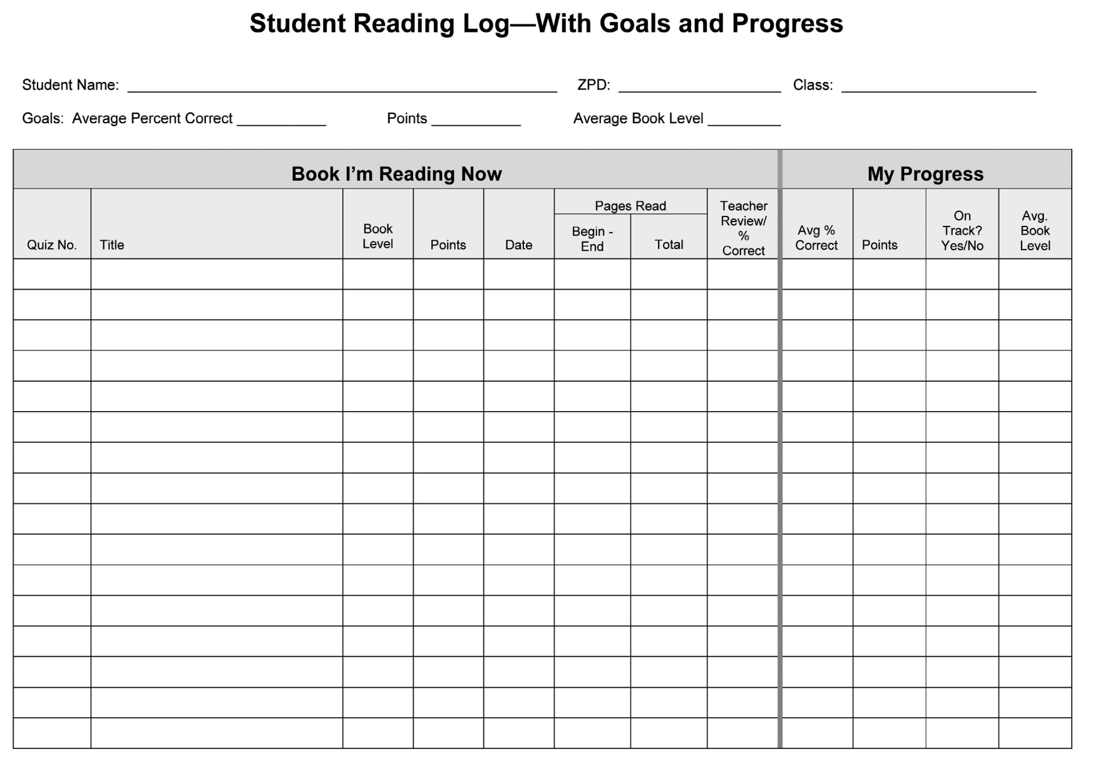
KS2 Record Keeping
KS2 Sticker and Log Sheet to be kept in Reading Diaries.

Slide 18
Reading Diary Record Sheet.
Accelerated Reader Book Record
Date | Title of Book | Book Level | Quiz Number | Quiz Date | % score | Points scored

Slide 19
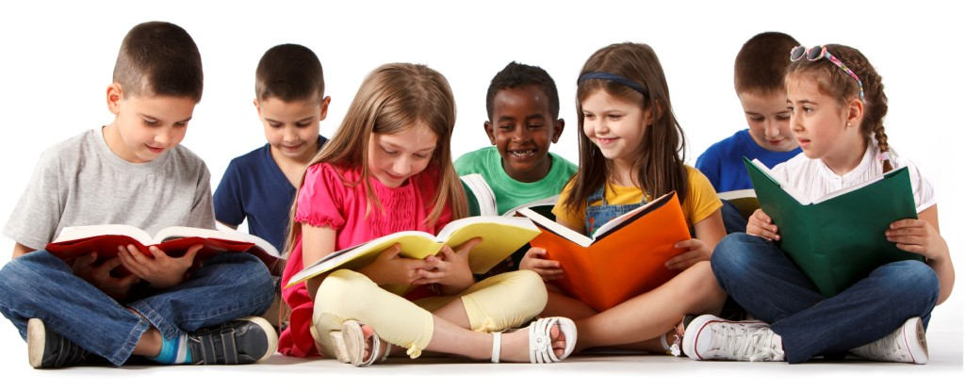
Learning and reading together…
Should be fun!

Slide 20
Q & A

Slide 21
Guided Reading.

Slide 22
Questions
What colour is The BFG’s cloak?
Which sentence tells us that The BFG does not wash his clothes very well?
Explain what the word “faded” means here.
Why do you think The BFG had cut holes in his sandals?
Find the word which makes you think that his sandals are rather funny.
“She was trembling like a leaf in the wind, and a finger of ice was running up and down her spine.” How does the author want you to feel by the words he uses in this sentence?
How do we know that The BFG had a very loud voice?
Which language technique does the author use to help us imagine how loud The BFG is?

